Slide 1
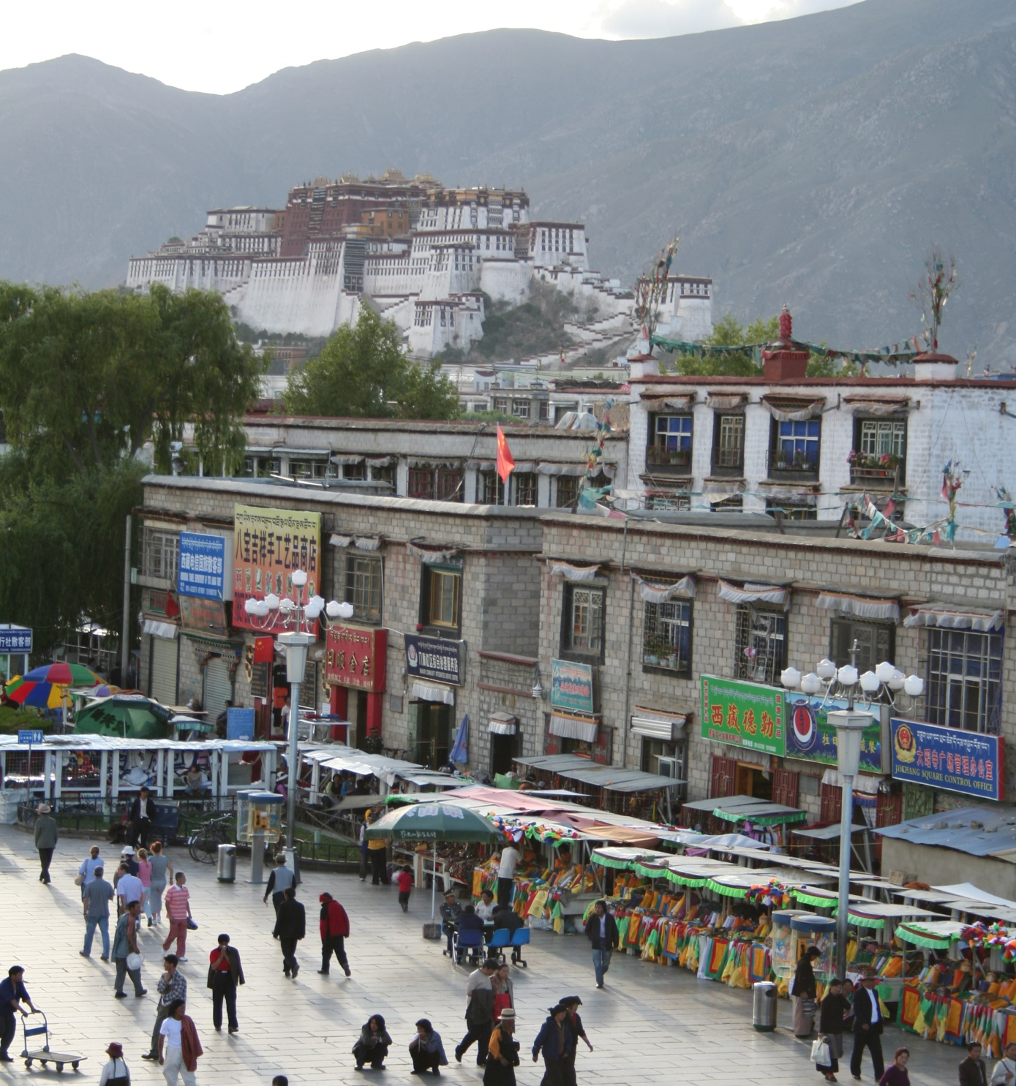
Introduction to semantic vision
mountain
tree
building
banner
street lamp
vendor
people
Note: course materials are prepared based 1) NYU Prof. Edward Wong and CMU Prof. Ioannis Computer Vision Class

Slide 2
Overview of today’s lecture
New in this lecture:
Introduction to semantic vision.
Image classification.
Bag-of-words.
K-means clustering.
Classification.
K nearest neighbors.
Naïve Bayes.
Support vector machine.

Slide 3
Slide credits
Most of these slides were adapted from:
Kris Kitani (16-385, Spring 2017).
Noah Snavely (Cornell University).
Fei-Fei Li (Stanford University).

Slide 4
What do we mean by ‘semantic vision’?

Slide 5
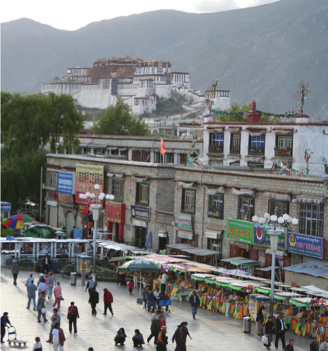
Is this a street light?
(Verification / classification)

Slide 6
Where are the people?
(Detection)

Slide 7
Is that Potala palace?
(Identification)

Slide 8

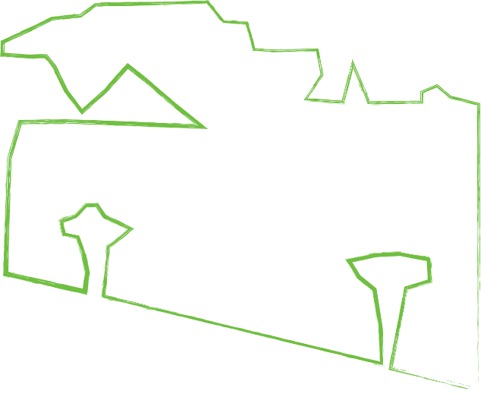
Sky
What’s in the scene?
(semantic segmentation)
Mountain
Trees
Building
Vendors
People
Ground

Slide 9
Object categorization
mountain
tree
building
banner
street lamp
vendor
people

Slide 10
What type of scene is it?
(Scene categorization)
Outdoor
Marketplace
City

Slide 11
Activity / Event Recognition
what are these people doing?

Slide 12
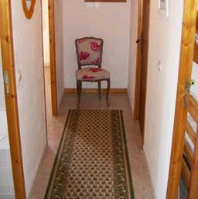

Object recognition Is it really so hard?
Find the chair in this image
Output of normalized correlation
This is a chair

Slide 13
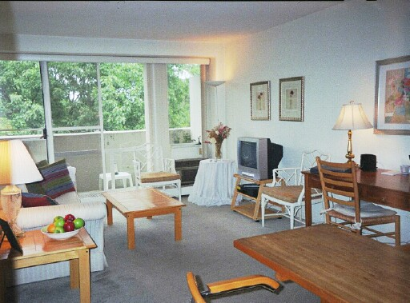
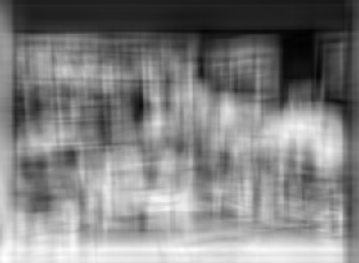
Object recognition Is it really so hard?
Find the chair in this image
Pretty much garbage
Simple template matching is not going to make it
A “popular method is that of template matching, by point to point correlation of a model pattern with the image pattern. These techniques are inadequate for three-dimensional scene analysis for many reasons, such as occlusion, changes in viewing angle, and articulation of parts.” Nivatia & Binford, 1977.

Slide 14
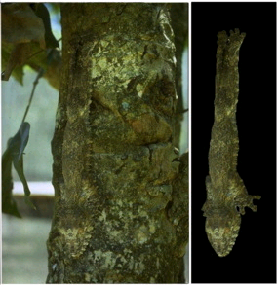
And it can get a lot harder
Brady, M. J., & Kersten, D. (2003). Bootstrapped learning of novel objects. J Vis, 3(6), 413-422

Slide 15
How do humans do recognition?
We don’t completely know yet
But we have some experimental observations.

Slide 16
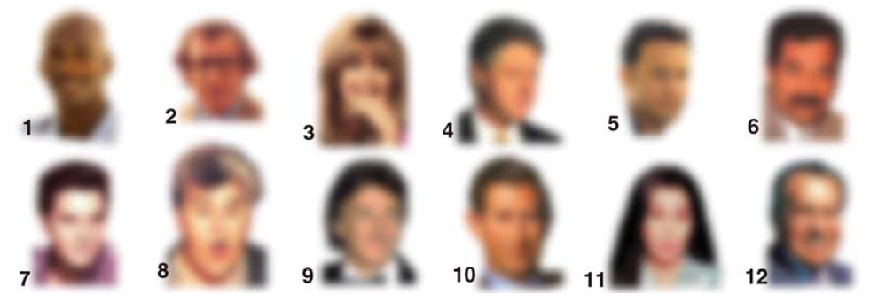
Observation 1
We can recognize familiar faces even in low-resolution images

Slide 17
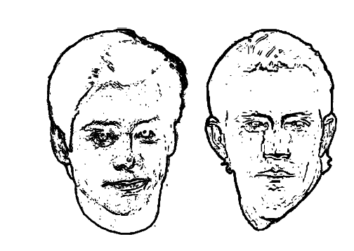
Observation 2:
Jim Carrey
Kevin Costner
High frequency information is not enough

Slide 18
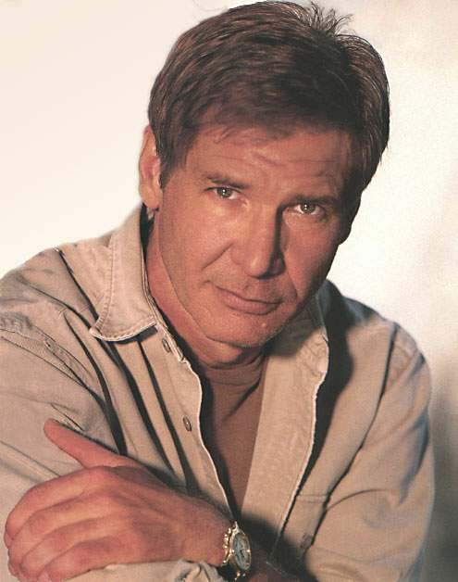
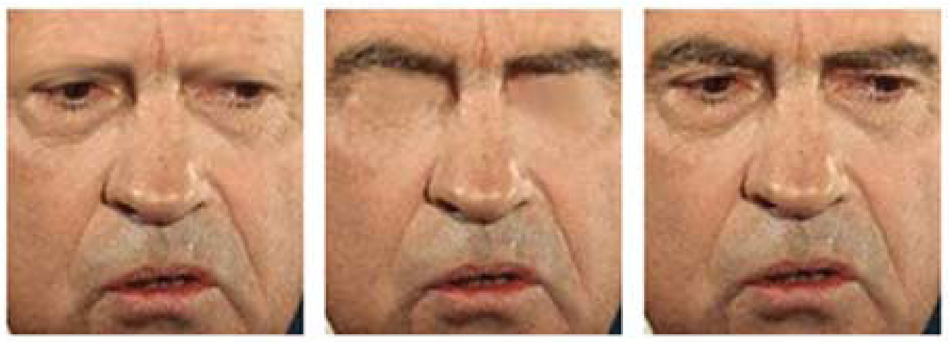
What is the single most important facial features for recognition?

Slide 19
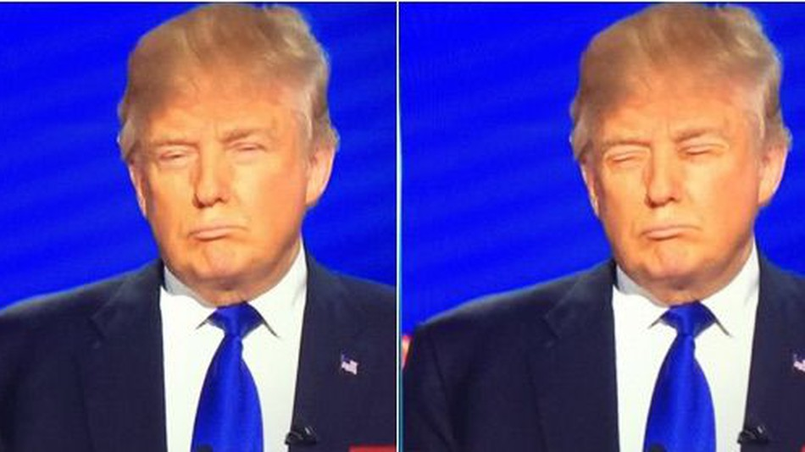
What is the single most important facial features for recognition?

Slide 20
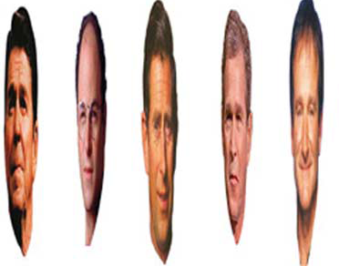
Observation 3:
Image Warping is OK

Slide 21
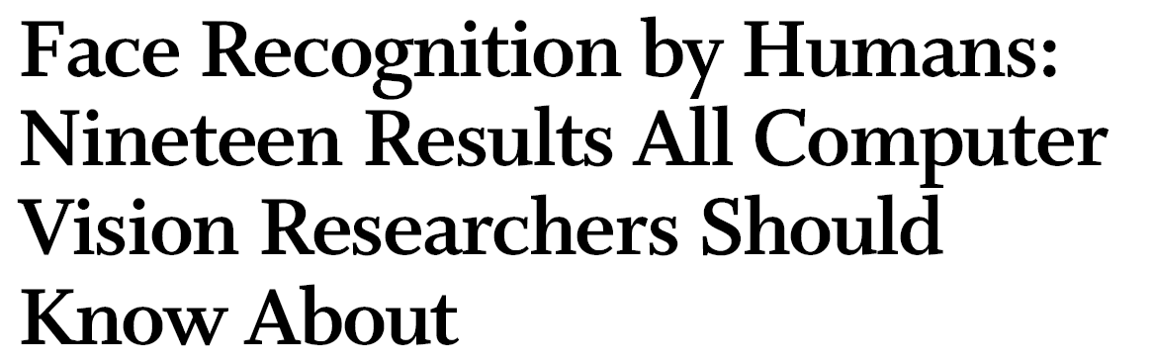
The list goes on

Slide 22
Why is this hard?
Variability:
Camera position
Illumination
Shape parameters
Notes:
One could argue that invariance is the key challenge to computer vision. But is this still true with big data?

Slide 23
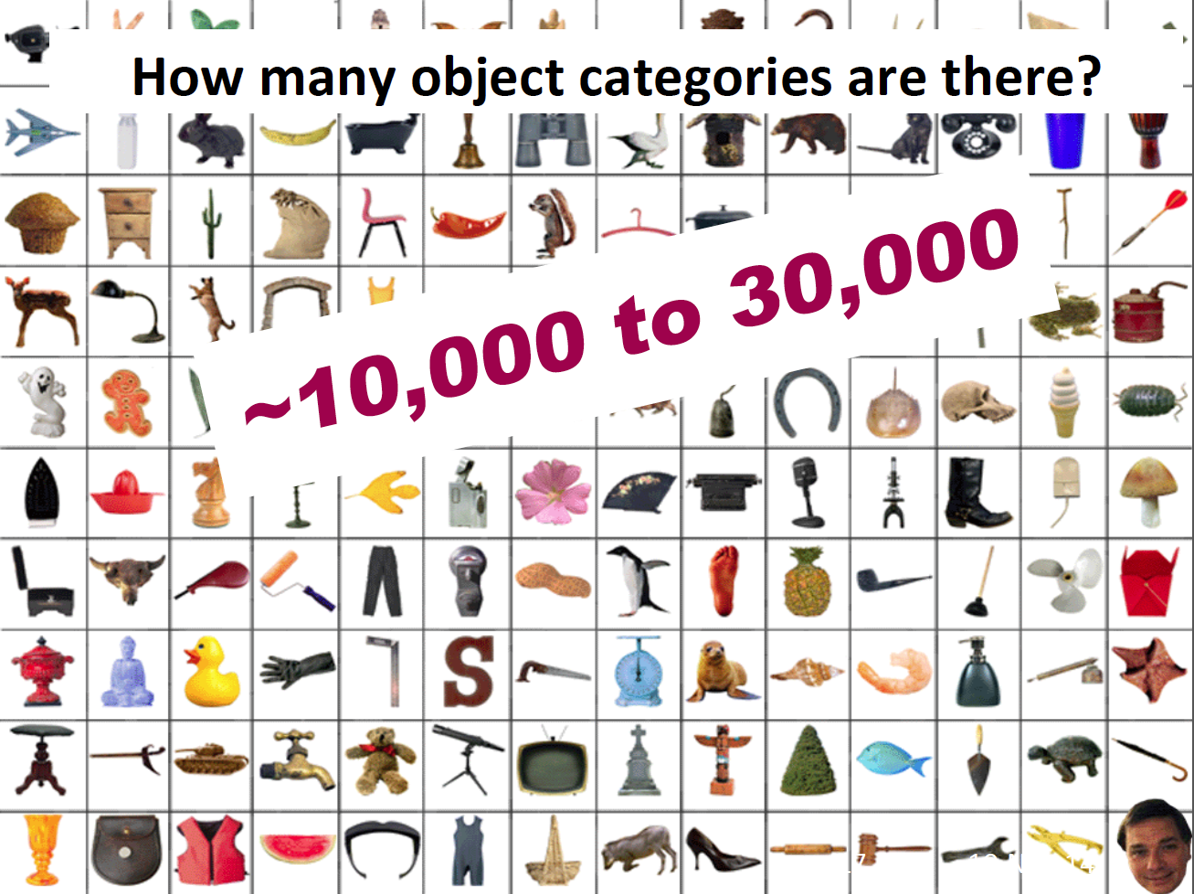

Slide 24
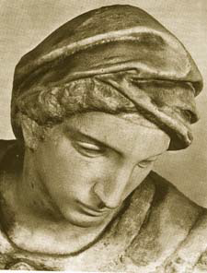
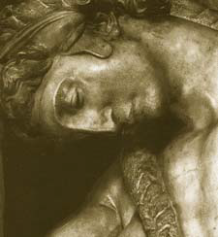
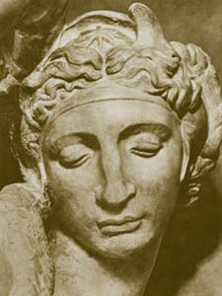
Challenge: variable viewpoint
Michelangelo 1475-1564

Slide 25
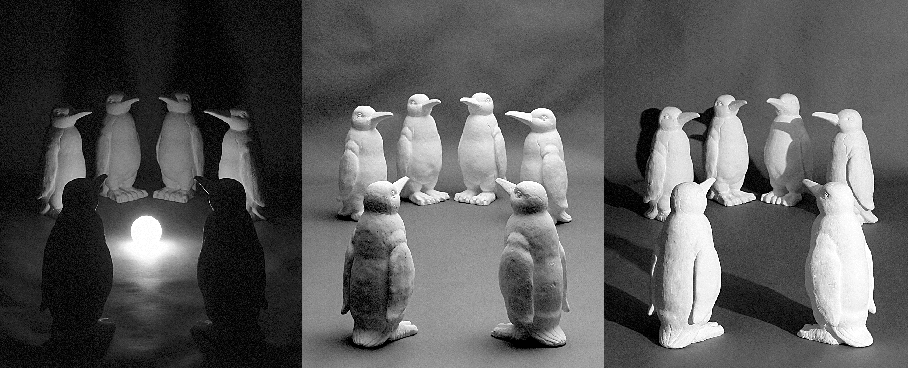
Challenge: variable illumination
image credit: J. Koenderink

Slide 26
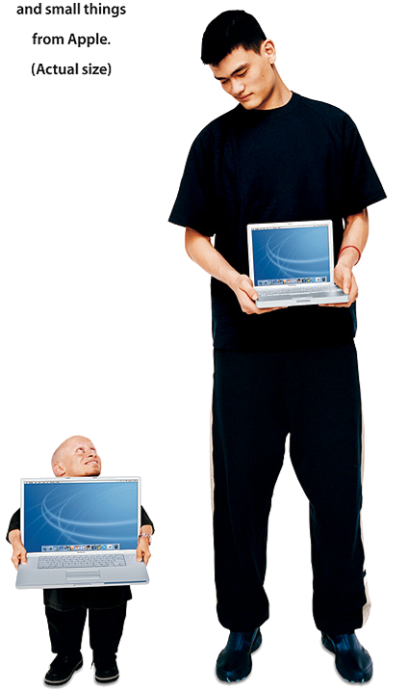
Challenge: scale

Slide 27
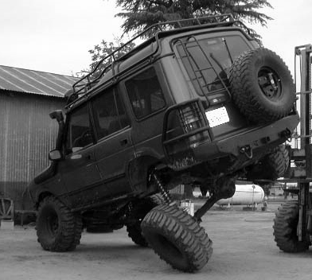
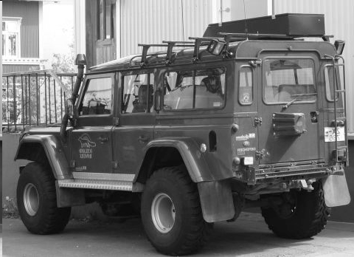
Challenge: deformation

Slide 28
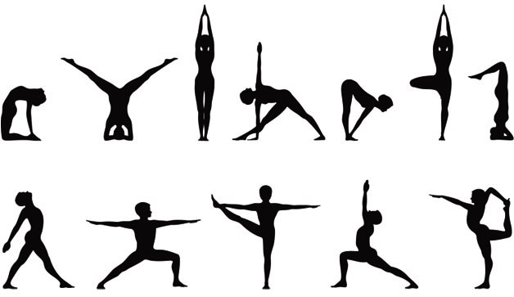
Deformation

Slide 29
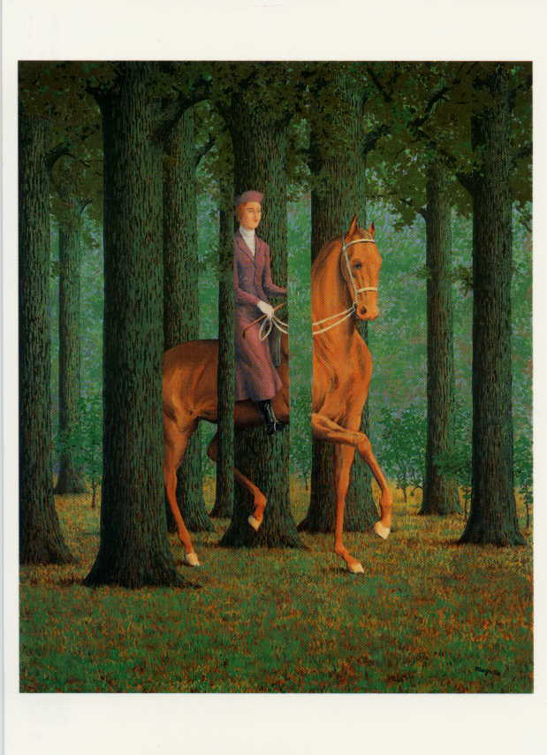
Challenge: Occlusion
Magritte, 1957

Slide 30
Occlusion

Slide 31
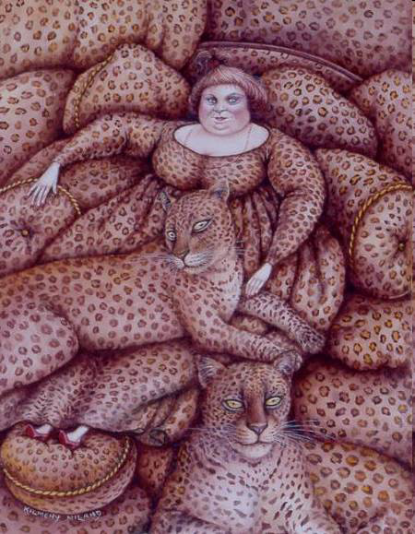
Challenge: background clutter
Kilmeny Niland. 1995

Slide 32
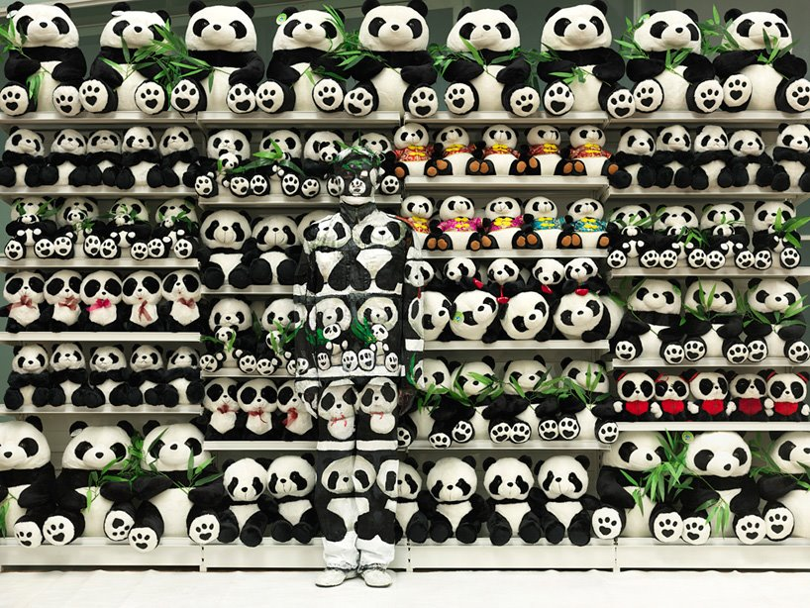
Challenge: Background clutter

Slide 33
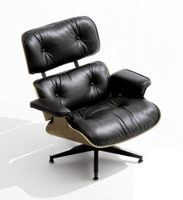
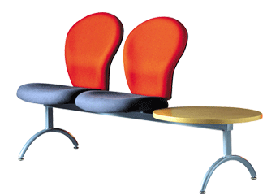
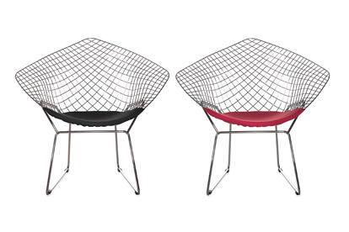
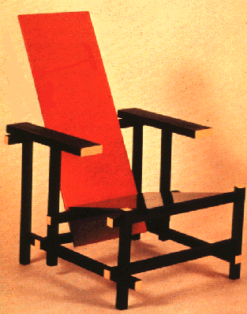
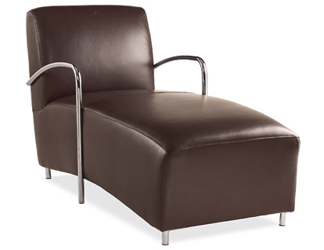
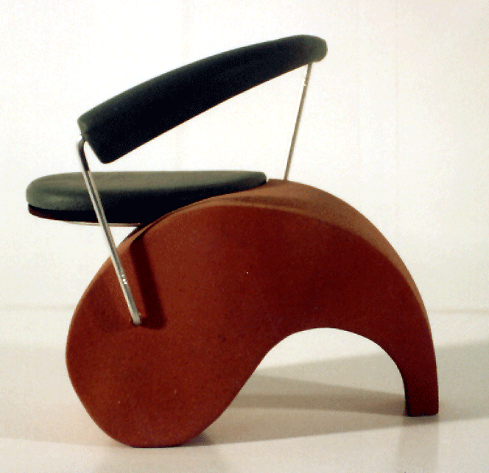
Challenge: intra-class variations
Svetlana Lazebnik
Notes:
Note English language issues. Try to not let language confound things.

Slide 34
Common approaches

Slide 35
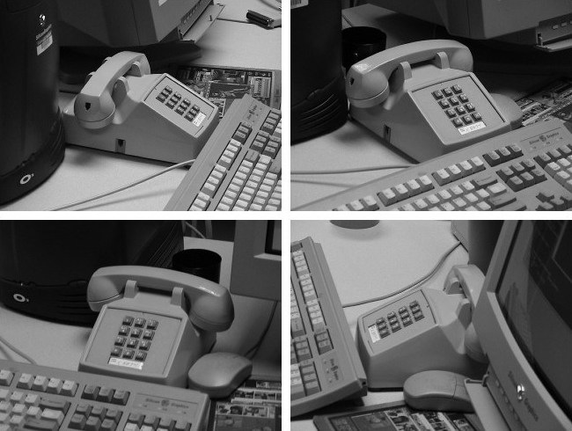
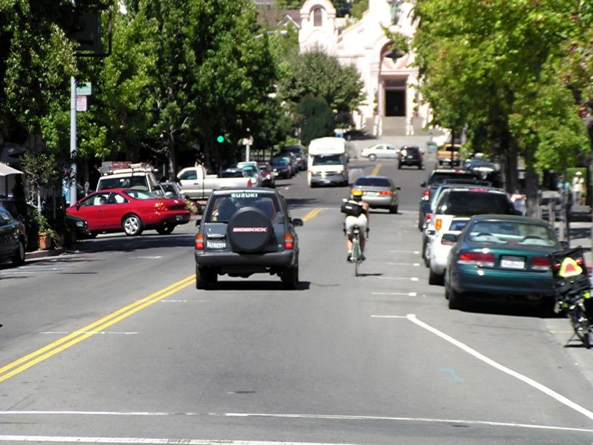
Common approaches:
object recognition
Feature Matching
Spatial
reasoning
Window classification

Slide 36
Feature matching

Slide 37
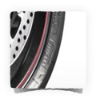

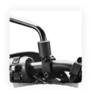
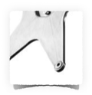
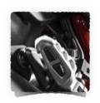
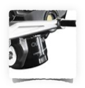
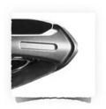


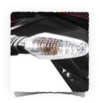
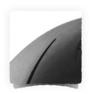
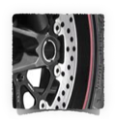
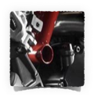

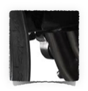
What object do these parts belong to?

Slide 38

Some local feature are very informative
An object as
a collection of local features
(bag-of-features)
deals well with occlusion
scale invariant
rotation invariant
Are the positions of the parts important?

Slide 39
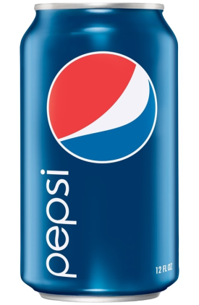

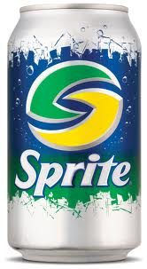
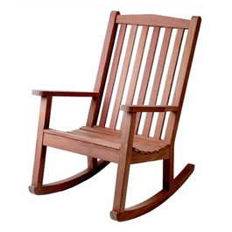
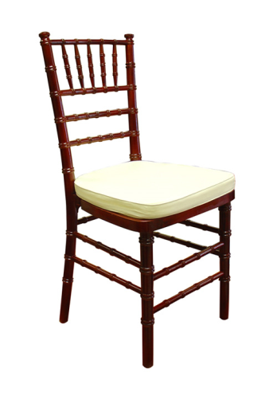
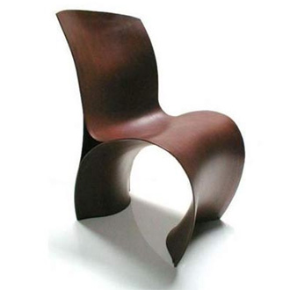
Why not use SIFT matching for everything?
Works well for object instances
Not great for generic object categories

Slide 40
Pros
Simple
Efficient algorithms
Robust to deformations
Cons
No spatial reasoning

Slide 41
Common approaches:
object recognition
Feature Matching
Spatial
reasoning
Window classification

Slide 42
Spatial reasoning

Slide 43




The position of every part depends on the positions of all the other parts
positional dependence
Many parts, many dependencies!

Slide 44

1. Extract features
2. Match features
3. Spatial verification

Slide 45
1. Extract features
2. Match features
3. Spatial verification

Slide 46
1. Extract features
2. Match features
3. Spatial verification
an old idea…

Slide 47


Fu and Booth. Grammatical Inference. 1975
Scene
Structural (grammatical) description

Slide 48




Slide 49







Description for left edge of face
1972

Slide 50

A more probabilistic approach…
think of locations as random variables (RV)
RV
RV
RV
vector of RVs: set of part locations
Notes:
p(\vec{L} | \vec{I}) \propto p( \vec{I} | \vec{L} ) p(\vec{L} )
\vec{L} = \{ L_1, L_2, \ldots, L_M \}
L_m = [ ~x~y~ ]

Slide 51




A more modern probabilistic approach…
think of locations as random variables (RV)
RV
RV
RV
vector of RVs: set of part locations
image (N pixels)
What are the dimensions of R.V. L?
How many possible combinations of part locations?
Notes:
p(\vec{L} | \vec{I}) \propto p( \vec{I} | \vec{L} ) p(\vec{L} )
\vec{L} = \{ L_1, L_2, \ldots, L_M \}
L_m = [ ~x~y~ ]

Slide 52

A more modern probabilistic approach…
think of locations as random variables (RV)
RV
RV
RV
vector of RVs: set of part locations
image (N pixels)
What are the dimensions of R.V. L?
How many possible combinations of part locations?
Notes:
p(\vec{L} | \vec{I}) \propto p( \vec{I} | \vec{L} ) p(\vec{L} )
\vec{L} = \{ L_1, L_2, \ldots, L_M \}
L_m = [ ~x~y~ ]

Slide 53

A more modern probabilistic approach…
think of locations as random variables (RV)
RV
RV
RV
vector of RVs: set of part locations
image (N pixels)
What are the dimensions of R.V. L?
How many possible combinations of part locations?
Notes:
p(\vec{L} | \vec{I}) \propto p( \vec{I} | \vec{L} ) p(\vec{L} )
\vec{L} = \{ L_1, L_2, \ldots, L_M \}
L_m = [ ~x~y~ ]

Slide 54




Most likely set of locations L is found by maximizing:
part locations
image
Posterior
Likelihood: How likely it is to observe image I given that the M parts are at locations L (scaled output of a classifier)
Prior: spatial prior controls the geometric configuration of the parts
What kind of prior can we formulate?

Slide 55

Given any collection of selfie images,
where would you expect the nose to be?
What would be an appropriate prior?
Notes:
P(L_{\textrm{nose}}) = ?
The center!

Slide 56

A simple factorized model
Break up the joint probability into smaller (independent) terms
Notes:
p(\vec{L}) = \prod_{m} p(L_m)

Slide 57

Independent locations
Each feature is allowed to move independently
Does not model the relative location of parts at all

Slide 58

Tree structure
(star model)
Root (reference) node
Represent the location of
all the parts relative to a single reference part
Assumes that one
reference part is defined (who will decide this?)

Slide 59

Fully connected
(constellation model)
Explicitly represents the
joint distribution of locations
Good model:
Models relative location of parts
BUT Intractable for moderate number of parts
positional dependence

Slide 60
Pros
Retains spatial constraints
Robust to deformations
Cons
Computationally expensive
Generalization to large inter-class variation (e.g., modeling chairs)

Slide 61
Feature Matching
Spatial
reasoning
Window classification

Slide 62
Window-based

Slide 63



Template Matching
1. get image window
2. extract features
3. classify
When does this work and when does it fail?
How many templates do you need?

Slide 64
Per-exemplar
exemplar
template
top hits from test data
find the ‘nearest’ exemplar, inherit its label

Slide 65

Template Matching
get image window (or region proposals)
2. extract features
3. compare to template
Do this part with one big classifier
‘end to end learning’

Slide 66


Convolutional Neural Networks
Convolution
Pooling
Image patch
(raw pixels values)
Image patch
(raw pixels values)
max/min response over a region
response of one ‘filter’
response of one ‘filter’
A 96 x 96 image convolved with 400 filters (features) of size 8 x 8 generates about 3 million values (89²x400)
Pooling aggregates statistics and lowers the dimension of convolution

Slide 67



Slide 68


96 ‘filters’
224/4=56
630 million connections
60 millions parameters to learn
Krizhevsky, A., Sutskever, I. and Hinton, G. E.
ImageNet Classification with Deep Convolutional Neural Networks, NIPS 2012.

Slide 69
Pros
Retains spatial constraints
Efficient test time performance
Cons
Many many possible windows to evaluate
Requires large amounts of data
Sometimes (very) slow to train

Slide 70
History of ideas in recognition
1960s – early 1990s: the geometric era
1990s: appearance-based models
Mid-1990s: sliding window approaches
Late 1990s: local features
Early 2000s: parts-and-shape models
Mid-2000s: bags of features
Present trends: data-driven methods, deep learning

Slide 71
What Matters in Recognition?
Learning Techniques
E.g. choice of classifier or inference method
Representation
Low level: SIFT, HoG, GIST, edges
Mid level: Bag of words, sliding window, deformable model
High level: Contextual dependence
Deep features
Data
More is always better
Annotation is the hard part

Slide 72
Types of Recognition
Instance recognition
Recognizing a known object but in a new viewpoint, with clutter and occlusion
Location/Landmark Recognition
Recognize Paris, Rome, ... in photographs
Ideas from information retrieval
Category recognition
Harder problem, even for humans
Bag of words, part-based, recognition and segmentation

Slide 73

Simultaneous recognition and detection
Notes:
Label each pixel with its class (say dog, grass) and use CRF to do the segmentation.

Slide 74


PASCAL VOC 2005-2012
20 object classes 22,591 images
Classification: person, motorcycle
Detection
Segmentation
Person
Motorcycle
Action: riding bicycle
Everingham, Van Gool, Williams, Winn and Zisserman.
The PASCAL Visual Object Classes (VOC) Challenge. IJCV 2010.

Slide 75


20 object categories (aeroplane to TV/monitor)
Three (+2) challenges:
Classification challenge (is there an X in this image?)
Detection challenge (draw a box around every X)
Segmentation challenge (which class is each pixel?)
Notes:
+2 action classification and person layout.

Slide 76

Notes:
Images downloaded from flickr. 500k images downloaded. Random subset selected for annotation.
Full annotation

Slide 77


is
is there a cat?

Slide 78

Pascal VOC 2007 Average Precision
Notes:
2007 was not the first year, but it’s the first year with 20 classes and the same evaluation metric (AP vs Area under ROC)

Slide 79

Pascal VOC 2012 Average Precision

Slide 80



Slide 81


Slide 82


Slide 83


Slide 84


Slide 85


Slide 86
Where to from here?
Scene Understanding
Big data – lots of images
Crowd-sourcing – lots of people
Deep Learning – lots of compute

Slide 87

24 Hrs in Photos
http://www.kesselskramer.com/exhibitions/24-hrs-of-photos
installation by Erik Kessels

Slide 88


Slide 89
Data Sets
ImageNet
Huge, Crowdsourced, Hierarchical, Iconic objects
PASCAL VOC
Not Crowdsourced, bounding boxes, 20 categories
SUN Scene Database, Places
Not Crowdsourced, 397 (or 720) scene categories
LabelMe (Overlaps with SUN)
Sort of Crowdsourced, Segmentations, Open ended
SUN Attribute database (Overlaps with SUN)
Crowdsourced, 102 attributes for every scene
OpenSurfaces
Crowdsourced, materials
Microsoft COCO
Crowdsourced, large-scale objects

Slide 90

Large Scale Visual Recognition Challenge (ILSVRC) 2010-2012
20 object classes 22,591 images
1000 object classes 1,431,167 images
Dalmatian
http://image-net.org/challenges/LSVRC/{2010,2011,2012}

Slide 91

Variety of object classes in ILSVRC

Slide 92

Variety of object classes in ILSVRC

Slide 93



Notes:
899 categories from Abbey to Zoo
For each of those categories we perform keyword searches on the Internet to find candidate scenes, and manually filter each category according to strict guidelines (e.g. what distinguishes a pasture and a corral). We end up with 130, 519 images.
It turns out that, even with an Internet worth of imagery, some categories are sparsely sampled. For all the experiments in this talk, we used only the 397 well-sampled categories with at least 100 unique images.

Slide 94
Deep Learning or CNNs
Since 2012, huge impact…, best results
Can soak up all the data for better prediction

Slide 95


Slide 96
Image classification

Slide 97

Image Classification

Slide 98

Image Classification: Problem

Slide 99

Data-driven approach
Collect a database of images with labels
Use ML to train an image classifier
Evaluate the classifier on test images

Slide 100
Bag of words

Slide 101
What object do these parts belong to?

Slide 102
Some local feature are very informative
An object as
a collection of local features
(bag-of-features)
deals well with occlusion
scale invariant
rotation invariant

Slide 103
(not so) crazy assumption
spatial information of local features
can be ignored for object recognition (i.e., verification)

Slide 104

CalTech6 dataset
Works pretty well for image-level classification
Csurka et al. (2004), Willamowski et al. (2005), Grauman & Darrell (2005), Sivic et al. (2003, 2005)

Slide 105
Bag-of-features
represent a data item (document, texture, image)
as a histogram over features
an old idea
(e.g., texture recognition and information retrieval)

Slide 106






Texture recognition
histogram
Universal texton dictionary

Slide 107


Vector Space Model
G. Salton. ‘Mathematics and Information Retrieval’ Journal of Documentation,1979
1 | 6 | 2 | 1 | 0 | 0 | 0 | 1
Tartan | robot | CHIMP | CMU | bio | soft | ankle | sensor
0 | 4 | 0 | 1 | 4 | 5 | 3 | 2
Tartan | robot | CHIMP | CMU | bio | soft | ankle | sensor
http://www.fodey.com/generators/newspaper/snippet.asp

Slide 108


A document (datapoint) is a vector of counts over each word (feature)
counts the number of occurrences
just a histogram over words
What is the similarity between two documents?

Slide 109


A document (datapoint) is a vector of counts over each word (feature)
counts the number of occurrences
just a histogram over words
What is the similarity between two documents?
Use any distance you want but the cosine distance is fast.

Slide 110
but not all words are created equal

Slide 111

TF-IDF
Term Frequency Inverse Document Frequency
weigh each word by a heuristic
inverse document frequency
term frequency
(down-weights common terms)

Slide 112
Standard BOW pipeline
(for image classification)

Slide 113
Dictionary Learning:
Learn Visual Words using clustering
Encode:
build Bags-of-Words (BOW) vectors
for each image
Classify:
Train and test data using BOWs

Slide 114



Dictionary Learning:
Learn Visual Words using clustering
1. extract features (e.g., SIFT) from images

Slide 115
Dictionary Learning:
Learn Visual Words using clustering
2. Learn visual dictionary (e.g., K-means clustering)

Slide 116
What kinds of features can we extract?

Slide 117

Regular grid
Vogel & Schiele, 2003
Fei-Fei & Perona, 2005
Interest point detector
Csurka et al. 2004
Fei-Fei & Perona, 2005
Sivic et al. 2005
Other methods
Random sampling (Vidal-Naquet & Ullman, 2002)
Segmentation-based patches (Barnard et al. 2003)

Slide 118


Compute SIFT descriptor
[Lowe’99]
Normalize patch
Detect patches
[Mikojaczyk and Schmid ’02]
[Mata, Chum, Urban & Pajdla, ’02]
[Sivic & Zisserman, ’03]

Slide 119
…

Slide 120
How do we learn the dictionary?

Slide 121
…

Slide 122
…
Clustering

Slide 123
Visual vocabulary
…
Clustering

Slide 124
K-means clustering

Slide 125
1. Select initial centroids at random

Slide 126
1. Select initial centroids at random
2. Assign each object to the cluster with the nearest centroid.

Slide 127
1. Select initial centroids at random
2. Assign each object to the cluster with the nearest centroid.
3. Compute each centroid as the mean of the objects assigned to it (go to 2)

Slide 128
1. Select initial centroids at random
2. Assign each object to the cluster with the nearest centroid.
3. Compute each centroid as the mean of the objects assigned to it (go to 2)
2. Assign each object to the cluster with the nearest centroid.

Slide 129
1. Select initial centroids at random
2. Assign each object to the cluster with the nearest centroid.
3. Compute each centroid as the mean of the objects assigned to it (go to 2)
2. Assign each object to the cluster with the nearest centroid.
Repeat previous 2 steps until no change

Slide 130
K-means Clustering
Given k:
Select initial centroids at random.
Assign each object to the cluster with the nearest centroid.
Compute each centroid as the mean of the objects assigned to it.
Repeat previous 2 steps until no change.

Slide 131
From what data should I learn the dictionary?
Codebook can be learned on separate training set
Provided the training set is sufficiently representative, the codebook will be “universal”

Slide 132
From what data should I learn the dictionary?
Dictionary can be learned on separate training set
Provided the training set is sufficiently representative, the dictionary will be “universal”

Slide 133

Example visual dictionary

Slide 134

















Example dictionary
…
Appearance codebook
Source: B. Leibe

Slide 135

Another dictionary
…
…
…
…
…
Appearance codebook
Source: B. Leibe

Slide 136
Dictionary Learning:
Learn Visual Words using clustering
Encode:
build Bags-of-Words (BOW) vectors
for each image
Classify:
Train and test data using BOWs

Slide 137

1. Quantization: image features gets associated to a visual word (nearest cluster center)
Encode:
build Bags-of-Words (BOW) vectors
for each image

Slide 138

Encode:
build Bags-of-Words (BOW) vectors
for each image
2. Histogram: count the number of visual word occurrences

Slide 139
frequency
…..
codewords

Slide 140
Dictionary Learning:
Learn Visual Words using clustering
Encode:
build Bags-of-Words (BOW) vectors
for each image
Classify:
Train and test data using BOWs

Slide 141
K nearest neighbors
Support Vector Machine
Naïve Bayes

Slide 142
K nearest neighbors

Slide 143
Distribution of data from two classes

Slide 144
Distribution of data from two classes
Which class does q belong too?

Slide 145
Distribution of data from two classes
Look at the neighbors

Slide 146



K-Nearest Neighbor (KNN) Classifier
Non-parametric pattern classification approach
Consider a two class problem where each sample consists of two measurements (x,y).
For a given query point q, assign the class of the nearest neighbor
k = 1
Compute the k nearest neighbors and assign the class by majority vote.
k = 3

Slide 147

Nearest Neighbor is competitive
MNIST Digit Recognition
Handwritten digits
28x28 pixel images: d = 784
60,000 training samples
10,000 test samples
Test Error Rate (%)
Linear classifier (1-layer NN) | 12.0
K-nearest-neighbors, Euclidean | 5.0
K-nearest-neighbors, Euclidean, deskewed | 2.4
K-NN, Tangent Distance, 16x16 | 1.1
K-NN, shape context matching | 0.67
1000 RBF + linear classifier | 3.6
SVM deg 4 polynomial | 1.1
2-layer NN, 300 hidden units | 4.7
2-layer NN, 300 HU, [deskewing] | 1.6
LeNet-5, [distortions] | 0.8
Boosted LeNet-4, [distortions] | 0.7
Yann LeCunn

Slide 148
What is the best distance metric between data points?
Typically Euclidean distance
Locality sensitive distance metrics
Important to normalize. Dimensions have different scales
How many K?
Typically k=1 is good
Cross-validation (try different k!)

Slide 149


Distance metrics
Euclidean
Cosine
Chi-squared

Slide 150

Choice of distance metric
Hyperparameter

Slide 151

Visualization: L2 distance
Notes:
Background plays an unrealistically large role

Slide 152

CIFAR-10 and NN results

Slide 153

k-nearest neighbor
Find the k closest points from training data
Labels of the k points “vote” to classify

Slide 154
Hyperparameters
What is the best distance to use?
What is the best value of k to use?
i.e., how do we set the hyperparameters?
Very problem-dependent
Must try them all and see what works best

Slide 155


Slide 156


Slide 157

Validation

Slide 158

Cross-validation

Slide 159


Slide 160
How to pick hyperparameters?
Methodology
Train and test
Train, validate, test
Train for original model
Validate to find hyperparameters
Test to understand generalizability

Slide 161
Pros
simple yet effective
Cons
search is expensive (can be sped-up)
storage requirements
difficulties with high-dimensional data

Slide 162
kNN -- Complexity and Storage
N training images, M test images
Training: O(1)
Testing: O(MN)
Hmm…
Normally need the opposite
Slow training (ok), fast testing (necessary)

Slide 163


Slide 164
Support Vector Machine

Slide 165
Image Classification

Slide 166

Score function

Slide 167

Linear Classifier
data (histogram)

Slide 168

Convert image to histogram representation

Slide 169
Distribution of data from two classes
Which class does q belong too?

Slide 170
Distribution of data from two classes
Learn the decision boundary

Slide 171
First we need to understand hyperplanes…

Slide 172



Hyperplanes (lines) in 2D
a line can be written as dot product plus a bias
another version, add a weight 1 and push the bias inside

Slide 173
Hyperplanes (lines) in 2D
(offset/bias outside)
(offset/bias inside)

Slide 174
Hyperplanes (lines) in 2D
(offset/bias outside)
(offset/bias inside)
Important property:
Free to choose any normalization of w
The line
and the line
define the same line

Slide 175

What is the distance to origin?
(hint: use normal form)

Slide 176



distance to origin
scale
by
you get the normal form

Slide 177

What is the distance between two parallel lines?
(hint: use distance to origin)

Slide 178


distance between two parallel lines
Difference of distance to origin

Slide 179
Now we can go to 3D …
Hyperplanes (planes) in 3D
what are the dimensions of this vector?
What happens if you change b?

Slide 180

Hyperplanes (planes) in 3D

Slide 181

Hyperplanes (planes) in 3D
What’s the distance between these parallel planes?

Slide 182

Hyperplanes (planes) in 3D

Slide 183
What’s the best w?

Slide 184
What’s the best w?

Slide 185
What’s the best w?

Slide 186
What’s the best w?

Slide 187
What’s the best w?

Slide 188
What’s the best w?
Intuitively, the line that is the farthest from all interior points

Slide 189
What’s the best w?
Maximum Margin solution:
most stable to perturbations of data

Slide 190



What’s the best w?
support vectors
Want a hyperplane that is far away from ‘inner points’

Slide 191

Find hyperplane w such that …
margin
the gap between parallel hyperplanes
is maximized

Slide 192


Can be formulated as a maximization problem
What does this constraint mean?
label of the data point
Why is it +1 and -1?

Slide 193

Can be formulated as a maximization problem
Equivalently,
Where did the 2 go?
What happened to the labels?

Slide 194
‘Primal formulation’ of a linear SVM
Objective Function
Constraints
This is a convex quadratic programming (QP) problem
(a unique solution exists)

Slide 195
‘soft’ margin

Slide 196
What’s the best w?

Slide 197
What’s the best w?
Very narrow margin

Slide 198
Separating cats and dogs
Very narrow margin

Slide 199
What’s the best w?
Very narrow margin
Intuitively, we should allow for some misclassification if we can get more robust classification

Slide 200
What’s the best w?
Trade-off between the MARGIN and the MISTAKES
(might be a better solution)

Slide 201


Adding slack variables
misclassified point

Slide 202



‘soft’ margin
objective
subject to
for

Slide 203






‘soft’ margin
objective
subject to
for
The slack variable allows for mistakes,
as long as the inverse margin is minimized.

Slide 204
‘soft’ margin
objective
subject to
for
Every constraint can be satisfied if slack is large
C is a regularization parameter
Small C: ignore constraints (larger margin)
Big C: constraints (small margin)
Still QP problem (unique solution)

Slide 205


Slide 206


Slide 207
References
Basic reading:
Szeliski, Chapter 14.
Notes:
Ch

